Slide 1



IPL AUCTION PRICE PREDICTOR
Predict debuting IPL players auction prices using machine learning with multiple parameters
Session:2025-2026
DEPARTMENT OF INFORMATION TECHNOLOGY
HALDIA INSTITUTE OF TECHNOLOGY
Submitted To: Debasish Sahoo
Submitted By:
Name | University Roll Number | Email ID
Nilay Mandal | 10300224228 | nilaymondal356@gmail.com
Santanu Das | 10300224232 | santanudas.collegemail@gmail.com
Priyabrata Sen | 10300224230 | senpriyabrata2003@gmail.com

Slide 2

IPL Auction Price Prediction System
A machine learning-powered solution for data-driven player valuation in the Indian Premier League
Objective: Optimize franchise budget allocation using historical performance metrics.
Methodology: Predictive modeling via the Gaussian Naive Bayes algorithm.
Impact: Real-time valuation of "uncapped" and "star" players to minimize auction risks.

Slide 3
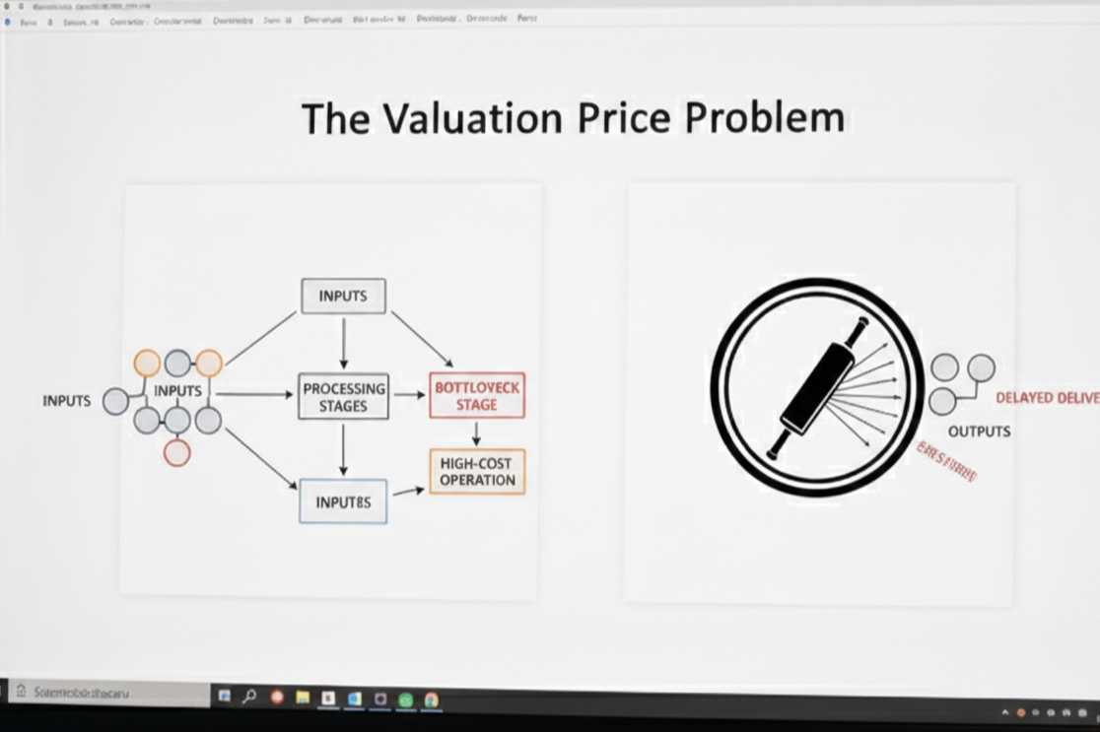
CHALLENGE
The Valuation Problem
IPL auction prices are influenced by numerous performance factors, making accurate valuation complex. Traditional manual approaches introduce subjectivity and inconsistency across team evaluations.
Teams need a systematic, data-driven valuation framework to make informed bidding decisions. Machine learning offers an automated solution to predict auction prices based on comprehensive performance analysis.

Slide 4
OBJECTIVES
Project Goals
Debut Player Focus
Comp. Analysis
Confidence Scoring
Web Platform
Predict IPL auction prices for first-time players entering the league
Evaluate 32 distinct player performance parameters
Provide price ranges with statistical confidence levels
Deliver an intuitive, user-friendly web application

Slide 5
SOLUTION
Our Approach
1. Data Input
2. ML Processing
3. Real-Time Output
Domestic cricket performance statistics
Advanced prediction algorithms
Instant auction price estimates
The system leverages machine learning to automate decision support, providing teams with objective, data-backed player valuations through an intuitive web interface.

Slide 6
System Architecture
Frontend Layer
React web application with responsive UI
Backend Layer
Flask REST API for data processing
ML Layer
Trained prediction model

Slide 7
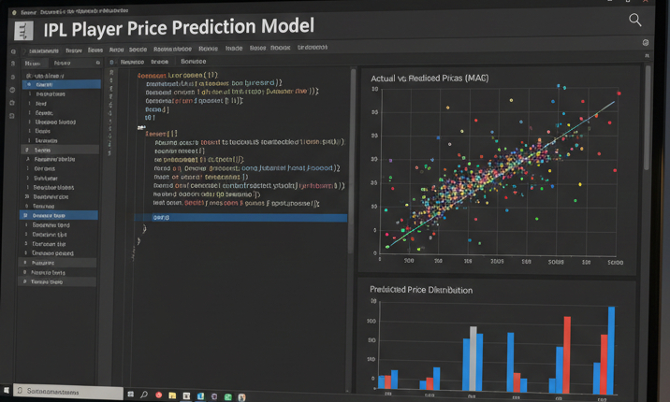
MODEL DETAILS
Machine Learning Implementation
Gaussian Naive Bayes Algorithm
Trained on 50,000 player records for robust performance
Classification-based approach using strategic price bins
Outputs prediction with statistical confidence score
Optimized for real-time inference speed

Slide 8
Dataset & Feature Engineering
50K
32
4
Player Records
Features
Player Roles
Comprehensive training dataset
Performance parameters
Position categories
Feature Categories
Batting performance metrics
Bowling statistics and variations
Fielding and wicket-keeping abilities
Overall match performance indicators

Slide 9

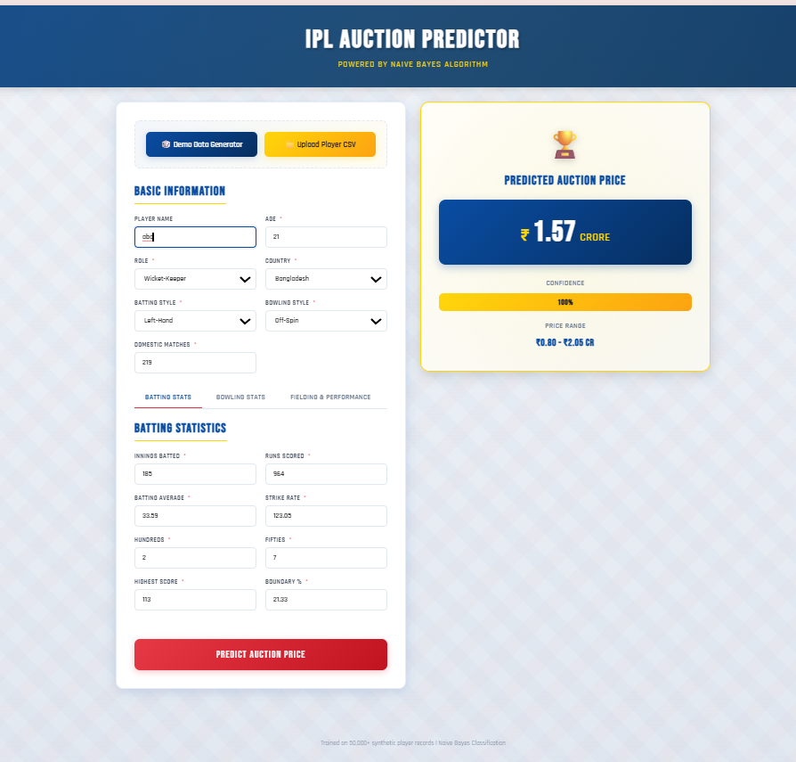
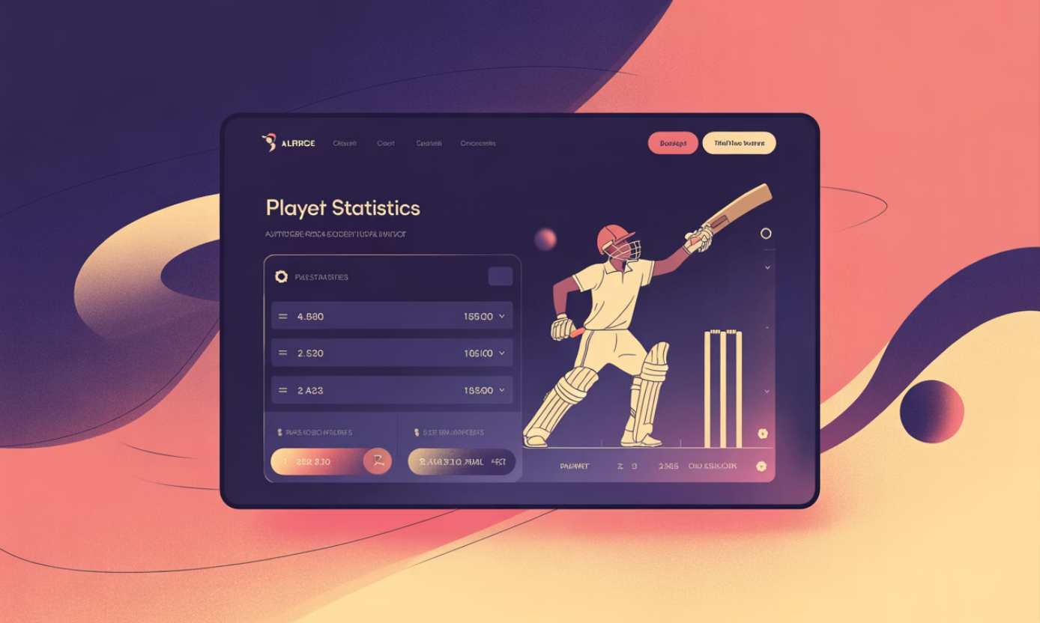
FEATURES
Web Application Capabilities
IPL-Themed Interface
Interactive React UI with authentic cricket aesthetics
Tabbed Navigation
Organized stat categories for easy data entry
Batch Processing
CSV upload for multiple player predictions
Smart Validation
Real-time error handling and input checks
Visual Results
Animated confidence meter and price display
Demo Mode
Auto-generate sample data for testing

Slide 10
System Execution Flow
1. Enter Stats
2. Validate Input
3. Send via API
4. Model Process
5. Predict Price
The system processes predictions in milliseconds, providing instant feedback through a seamless user experience. Each step includes built-in validation to ensure data quality and prediction accuracy.

Slide 11
Conclusion & Future Directions
Key Achievement
Future Opportunities
Successfully developed a machine learning-based IPL auction price predictor that demonstrates the powerful intersection of sports analytics and predictive modeling in real-world scenarios.
Integration with actual IPL auction datasets for enhanced accuracy
Implementation of advanced ensemble ML algorithms
Development of player comparison tools and budget optimization features

Slide 12

Thank You

